Slide 1


STOP PAYING CREDIT CARD FEES
How NetSuite Customers Are Recovering 2–3% of Revenue — Without Cutting Headcount, Raising Prices, or Waiting on IT
Ken Tyborski
CEO, Code of the North — NetSuite Alliance Partner
Notes:
Before we start, put in the chat: what would recovering 2–3% of your card volume mean to your business this year? I want to see your numbers. By the end of this session you'll know exactly why this fee hasn't been stopped yet, how other NetSuite customers fixed it in weeks, and what that number looks like on your P&L. You'll get out of this what you put in. If you're here and halfway paying attention, you'll leave with a framework. If you're locked in, you'll leave with a decision. This isn't about theory; it's about direct, measurable impact on your bottom line.

Slide 2











IS THIS WEBINAR FOR YOU?
IDEAL PROFILE
NOT A FIT IF...
CFO / VP Finance / Controller
Processing less than $1M annually
NetSuite customer
You're already surcharging
$10M+ in annual credit card volume
Pure D2C / consumer business
B2B: distribution, manufacturing, services
Located in a surcharge-permitted U.S. state
KEN TYBORSKI
CEO, Code of the North
Notes:
If you're a finance leader at a NetSuite shop accepting cards from business customers, you're in the right place. If you're not, no hard feelings. This is a very specific problem with a very specific solution. We're targeting a precise pain point, and if it's not yours, we won't waste your time. This focus ensures we deliver maximum value to those who truly need it. Now, let's clarify our shared objective for this session.

Slide 3
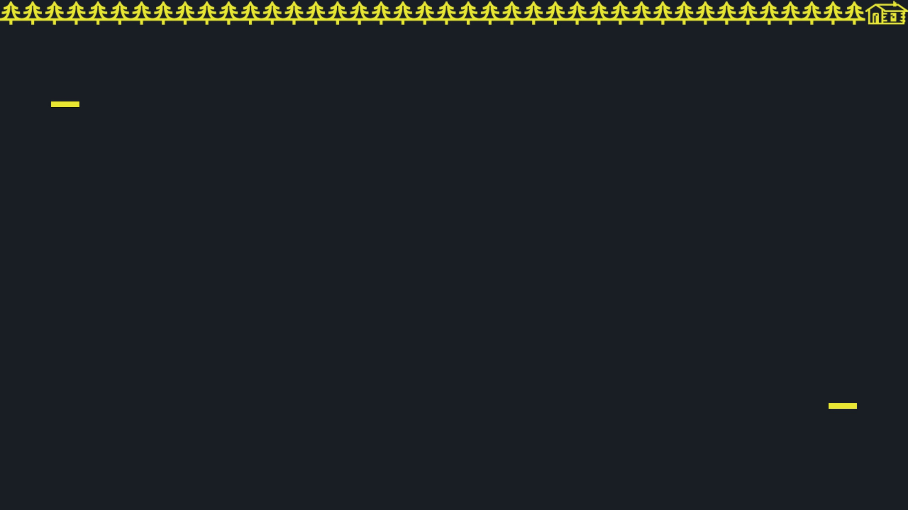
OUR SINGULAR OBJECTIVE
By the end of this webinar, you will know exactly how much your processor has taken from you — and exactly how to stop it.
Notes:
Our objective is singular and precise. One outcome. One number. One decision. That's all we're here to do today. You'll leave with a clear understanding of what your processor has been taking and a concrete path to stop it. This isn't about general advice; it's about actionable intelligence. To achieve this, we've structured our time efficiently.

Slide 4

ROADMAP FOR TODAY
01
02
03
THE PROBLEM
THE FIX
THE PATH
What's been silently draining your margin and why it hasn't been stopped yet.
How compliant surcharging works seamlessly inside your NetSuite environment.
What implementation looks like, what it costs, and how to start recovering revenue.
Notes:
We've got three parts. Forty-five minutes. No filler. Part one will probably make you uncomfortable. That's intentional. We'll expose the silent drain on your margin. Part three is where you'll decide if this is worth a conversation with my team. This roadmap ensures we cover the problem, the solution, and the implementation path directly. Before we dive in, let me quickly establish why we're the right team to guide you through this.

Slide 5



WHY CODE OF THE NORTH?
50+ IMPLEMENTATIONS
Proven track record of delivering complex NetSuite environments for high-growth B2B firms.
{ NETSUITE ALLIANCE PARTNER }
FINANCE SPECIALIZATION
Deep expertise in NetSuite finance modules, custom integrations, and payment infrastructure.
CODE OF THE NORTH
REAL-WORLD SURCHARGING
Live deployments processing significant volume. We build for compliance and scale.
Notes:
We are not a payments company that bolted onto NetSuite. We are a NetSuite firm that built a compliant surcharging implementation because our clients needed it and nothing else worked. We have over 50 NetSuite implementations under our belt, specializing in finance, integrations, and payment infrastructure. I'm going to show you what we built and what it recovered. This deep expertise means we understand your NetSuite environment intimately.

Slide 6



THREE BROKEN INDUSTRY MYTHS
MYTH #1
MYTH #2
MYTH #3
Processing fees are a fixed cost of business.
Surcharging is a complex IT project.
Customer defection risk is too high to act.
THE REALITY
THE REALITY
THE REALITY
No cost is fixed if the law allows you to shift it. Surcharging turns a 3% margin drain into a 0% expense.
It is a compliance decision. IT has no P&L accountability; every delay funds your processor's margins.
B2B buyers accepted fuel and material surcharges. This is no different—and your competitors are already moving.
// STATUS: DEBUNKED // SOURCE: CODE OF THE NORTH COMPLIANCE AUDIT
Notes:
We just talked about why our team is uniquely qualified to tackle this problem. Now, let's address the fundamental misunderstandings that keep companies from solving it. These three industry myths are costing you money every single day. First, the idea that payment processing fees are a fixed cost is simply false. The law allows you to shift this cost, turning a 3% drain into a 0% expense. Second, surcharging isn't an IT project; it's a compliance decision. IT doesn't have P&L accountability, so every delay directly funds your processor's margins. Finally, the fear of customer defection is overblown. B2B buyers have accepted fuel and material surcharges for years. This is no different, and your competitors are already making this move. Now, let's look at the real financial impact of these broken myths.

Slide 7
ANNUAL LEAKAGE DETECTED
$290,000
Gone this year. Quietly.
Calculated on $10M in annual credit card volume
"No one flagged it. No one stopped it."
THAT'S ON THE FINANCE TEAM.
Notes:
These myths lead directly to what we call the silent leak. This isn't a theoretical problem; it's a quarter-million-dollar reality for many of you. On just $10 million in card volume, $290,000 vanishes this year, quietly. No one flags it, no one stops it, and frankly, that's on the finance team. You've cut budgets, renegotiated contracts, and trimmed T&E. Yet, every month, without a meeting or a line item, 2.9% of your revenue goes straight to your processor. This isn't just about the fee; it's about the fact that no one has empowered you to stop it. Until now. So, what have companies tried to do about this?

Slide 8



ALTERNATIVES THAT DON'T WORK
RENEGOTIATE WITH PROCESSOR
BUILD CUSTOM SUITESCRIPT
DO NOTHING AND MONITOR
6–12 month IT project, open-ended cost, compliance not included.
Every month of monitoring is a month of donation. No neutral position.
Saves basis points. Does not eliminate the cost. Still your problem.
RESULT: HIGH RISK / HIGH COST
RESULT: CONTINUED LEAKAGE
RESULT: MARGINAL GAIN
Notes:
Given this silent leak, many companies try to address it with common, but ultimately ineffective, alternatives. First, renegotiating with your processor. This might save you basis points, but it doesn't eliminate the core cost. It's a marginal gain, not a solution. Second, building a custom SuiteScript. This is a 6-12 month IT project with open-ended costs and significant compliance risks. It's high risk and high cost for an uncertain outcome. Finally, doing nothing and monitoring. Every month you monitor is another month you donate to your processor. There's no neutral position here; inaction is a choice to keep paying. These approaches don't work because they fundamentally misunderstand the problem. So, what's the correct way to think about this?

Slide 9
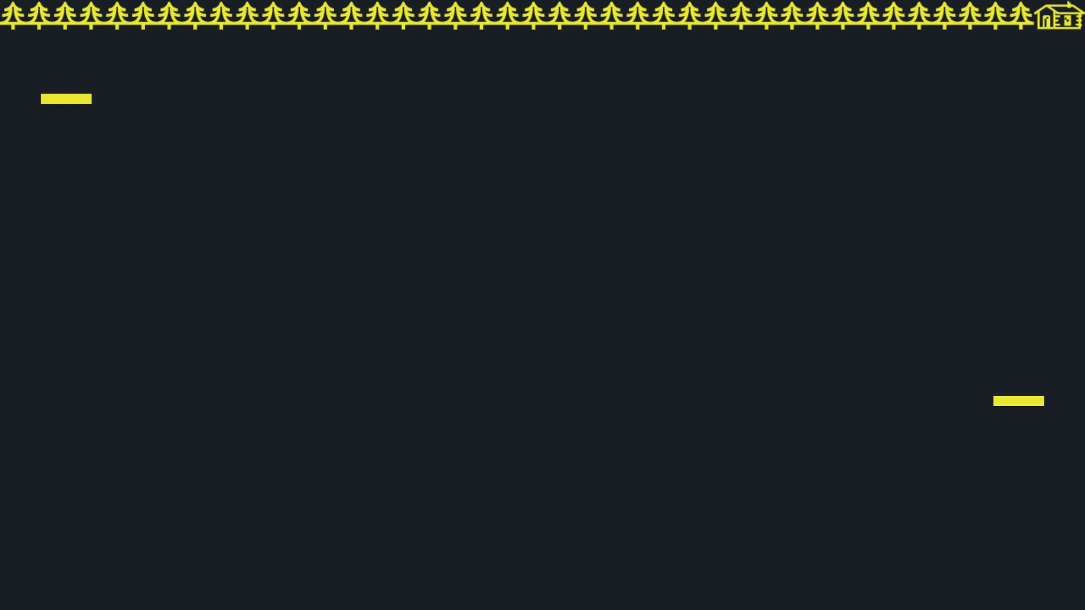
THE CORE REFRAME
SURCHARGING IS NOT AN IT PROJECT. IT IS A COMPLIANCE DECISION — AND EVERY NETSUITE CFO ALREADY HAS THE AUTHORITY TO MAKE IT.
The only thing standing between you and $200K–$300K in annual margin recovery is a six-week implementation.
Notes:
This brings us to the core reframe: surcharging is not an IT project. It is a compliance decision. Every NetSuite CFO already possesses the authority to make this decision. When you recognize this, the path to recovery becomes clear. The only thing standing between you and $200,000 to $300,000 in annual margin recovery is a six-week implementation. This isn't about development; it's about configuration and compliance, a decision that belongs squarely with finance. When finance owns it, implementation takes weeks, not quarters. But how do you know if this applies to you?

Slide 10
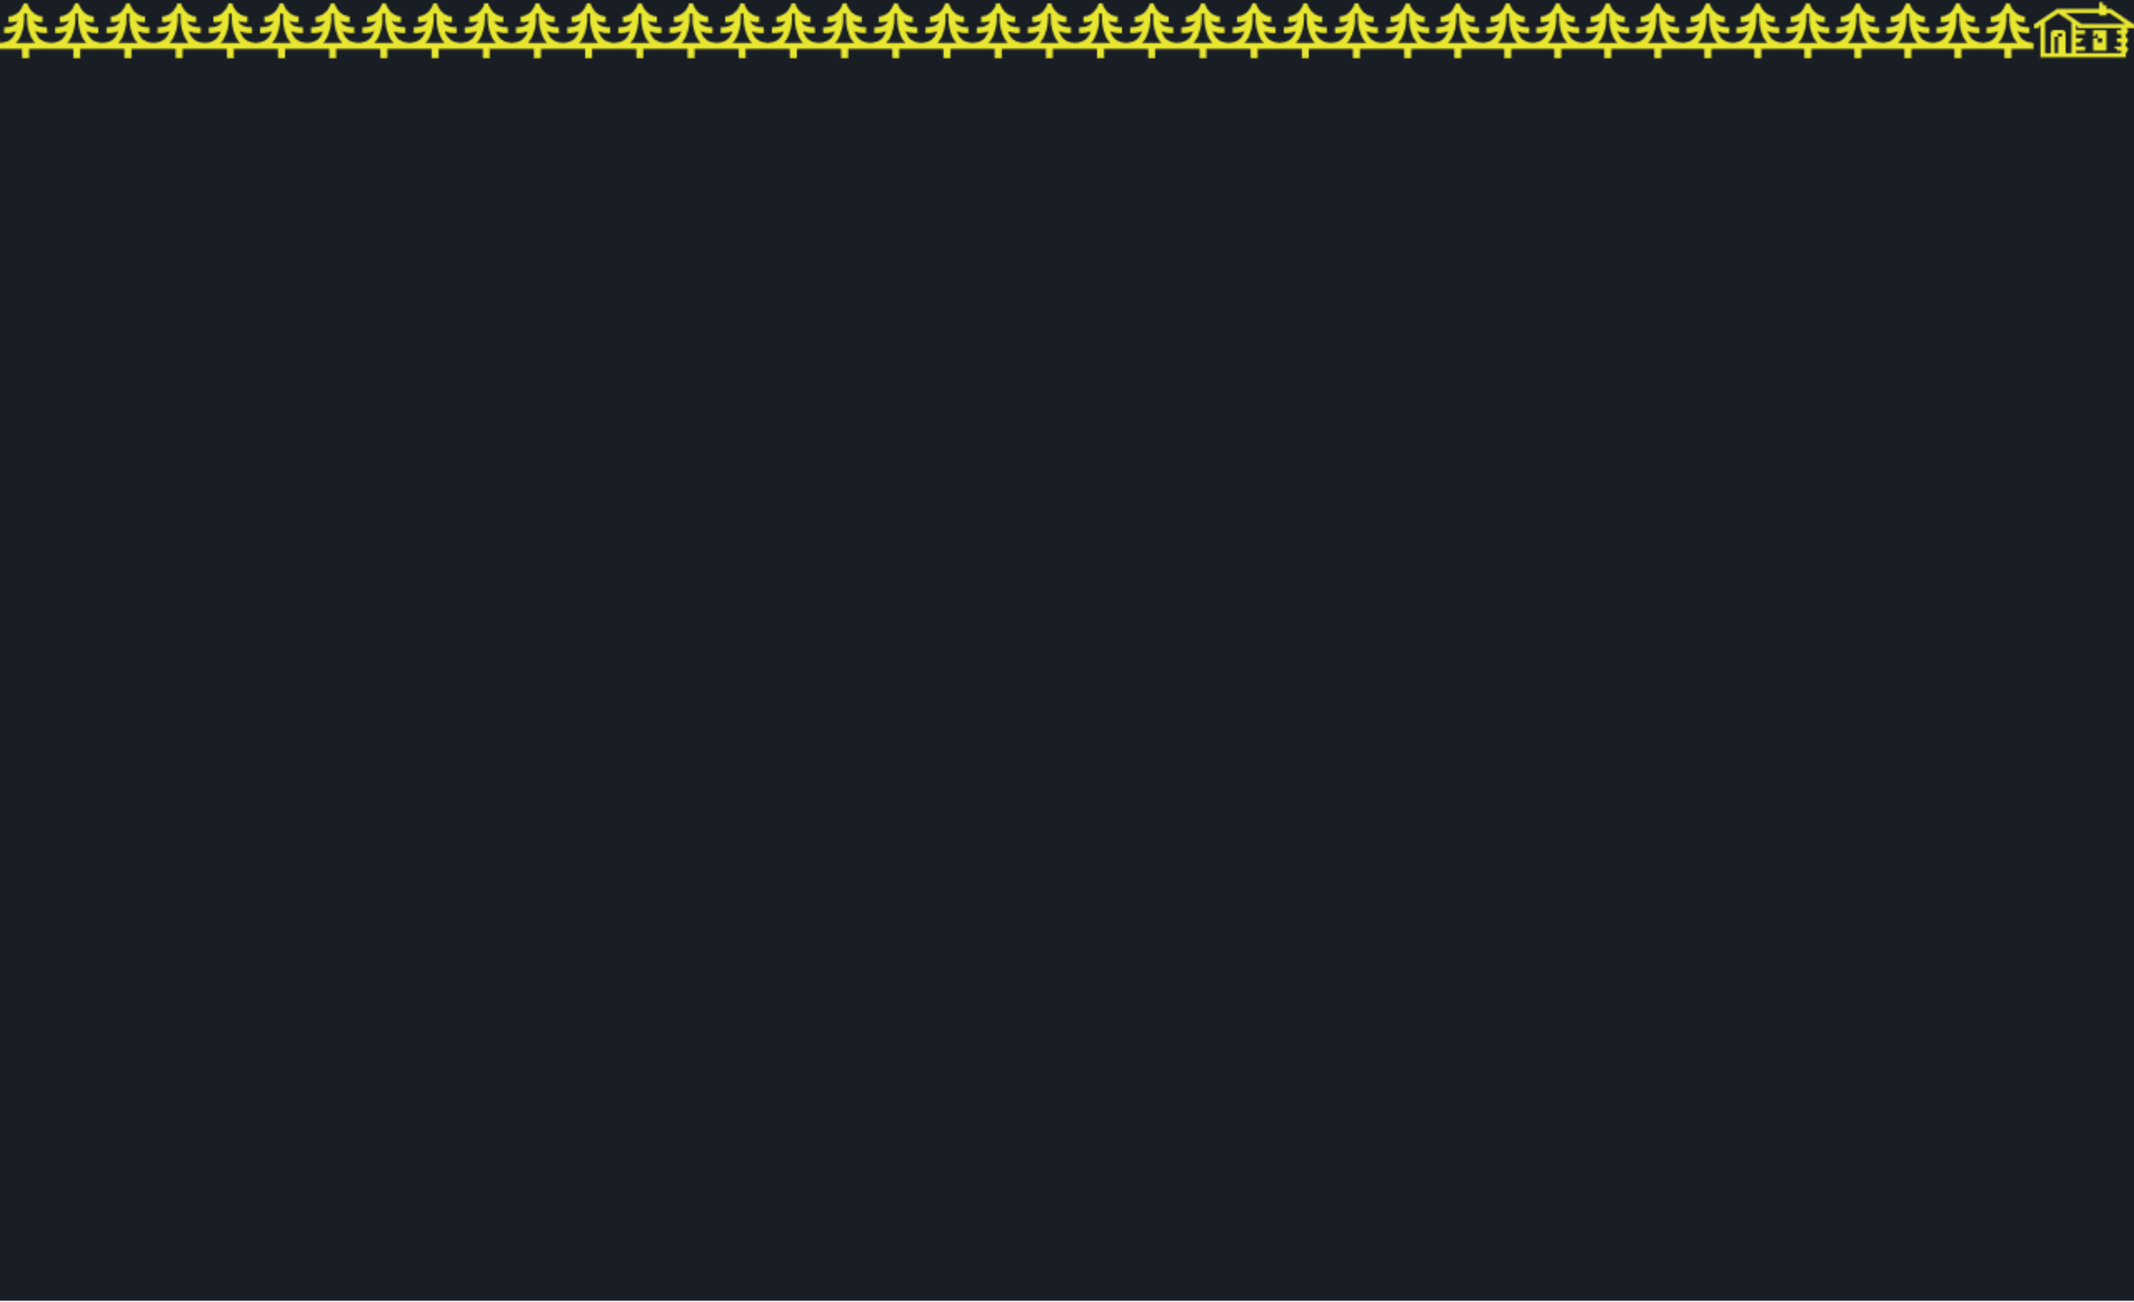



// INTERNAL AUDIT //
SIGNS YOU ARE LOSING MARGIN
Your processor fees are a line item nobody challenges in budget reviews.
IT has told you a surcharging project is "six months out" or "not on the roadmap."
You've wondered if your competitors are already surcharging to offset rising costs.
You've used "customer sensitivity" as a reason not to move—but never actually tested it.
Your CEO or board has started asking for aggressive margin improvement initiatives.
IF TWO OR MORE OF THESE LAND — YOU ARE THE IDEAL CANDIDATE.
Notes:
So, how do you know if you're experiencing this silent margin erosion? There are clear signs. If processor fees are a line item nobody challenges in your budget reviews, that's a symptom. If IT tells you surcharging is 'six months out' or 'not on the roadmap,' that's another. If you've wondered whether competitors are already doing this, or if you've used 'customer sensitivity' as an excuse without ever testing it, these are red flags. And if your board is asking for aggressive margin improvement, this is a direct answer. If two or more of these resonate with you, then you are exactly who this solution was built for. Now, let's look at what life looks like after you implement this.

Slide 11



THE RECOVERY BLUEPRINT
COMPLIANT SURCHARGING
NETSUITE INTEGRATION
RAPID DEPLOYMENT
Automatic, legal, and transparent. We handle the complex multi-state regulations so you don't have to.
Native, seamless, and automated. No manual journal entries or reconciliation nightmares.
Zero IT burden. We manage the implementation from end-to-end in six weeks or less.
50-State Compliance Audit
Real-time GL Impact
6-Week "Go Live" Guarantee
Automatic Card Type Detection
Automated Reconciliation
White-Glove Implementation
Transparent Receipting
Native Payment Link Support
Full Finance Team Training
Notes:
After you identify the problem, what does the solution actually deliver? It means you're recovering significant margin, not just talking about it. You'll see $200,000 to $300,000 annually on $10 million in card volume. This is real money, directly impacting your bottom line. And we're talking weeks to go live, not quarters. This isn't an IT project that gets bogged down. Finance owns this policy, and that means you control the timeline and the outcome. This leads us directly to how this plays out in the real world.

Slide 12
CASE STUDY: $100M DISTRIBUTOR
THE CHALLENGE
A multi-state distributor was processing $40M annually in credit cards, losing over $1.2M to processing fees. IT roadmap was full; finance was stuck.
ANNUAL RECOVERY
$1,160,000
THE SOLUTION
Code of the North implemented a compliant surcharging module within NetSuite in exactly 5 weeks, managing all legal notifications and GL mappings.
Straight to the Bottom Line
// CLIENT CONFIDENTIAL // NETSUITE ERP // GO-LIVE: OCT 2024
Notes:
We've seen the theory; now let's look at a concrete example of real margin recovery. This client was losing 2.9% on over $25 million in annual card volume, a silent drain on their profitability. Our three-step process—compliance audit, NetSuite configuration, and live surcharge line items—fixed it. The outcome? Over $180,000 recovered in the first quarter alone, with the entire implementation completed in just six weeks. This isn't just a concept; it's a proven financial win. So, how do you get these results for your business?

Slide 13
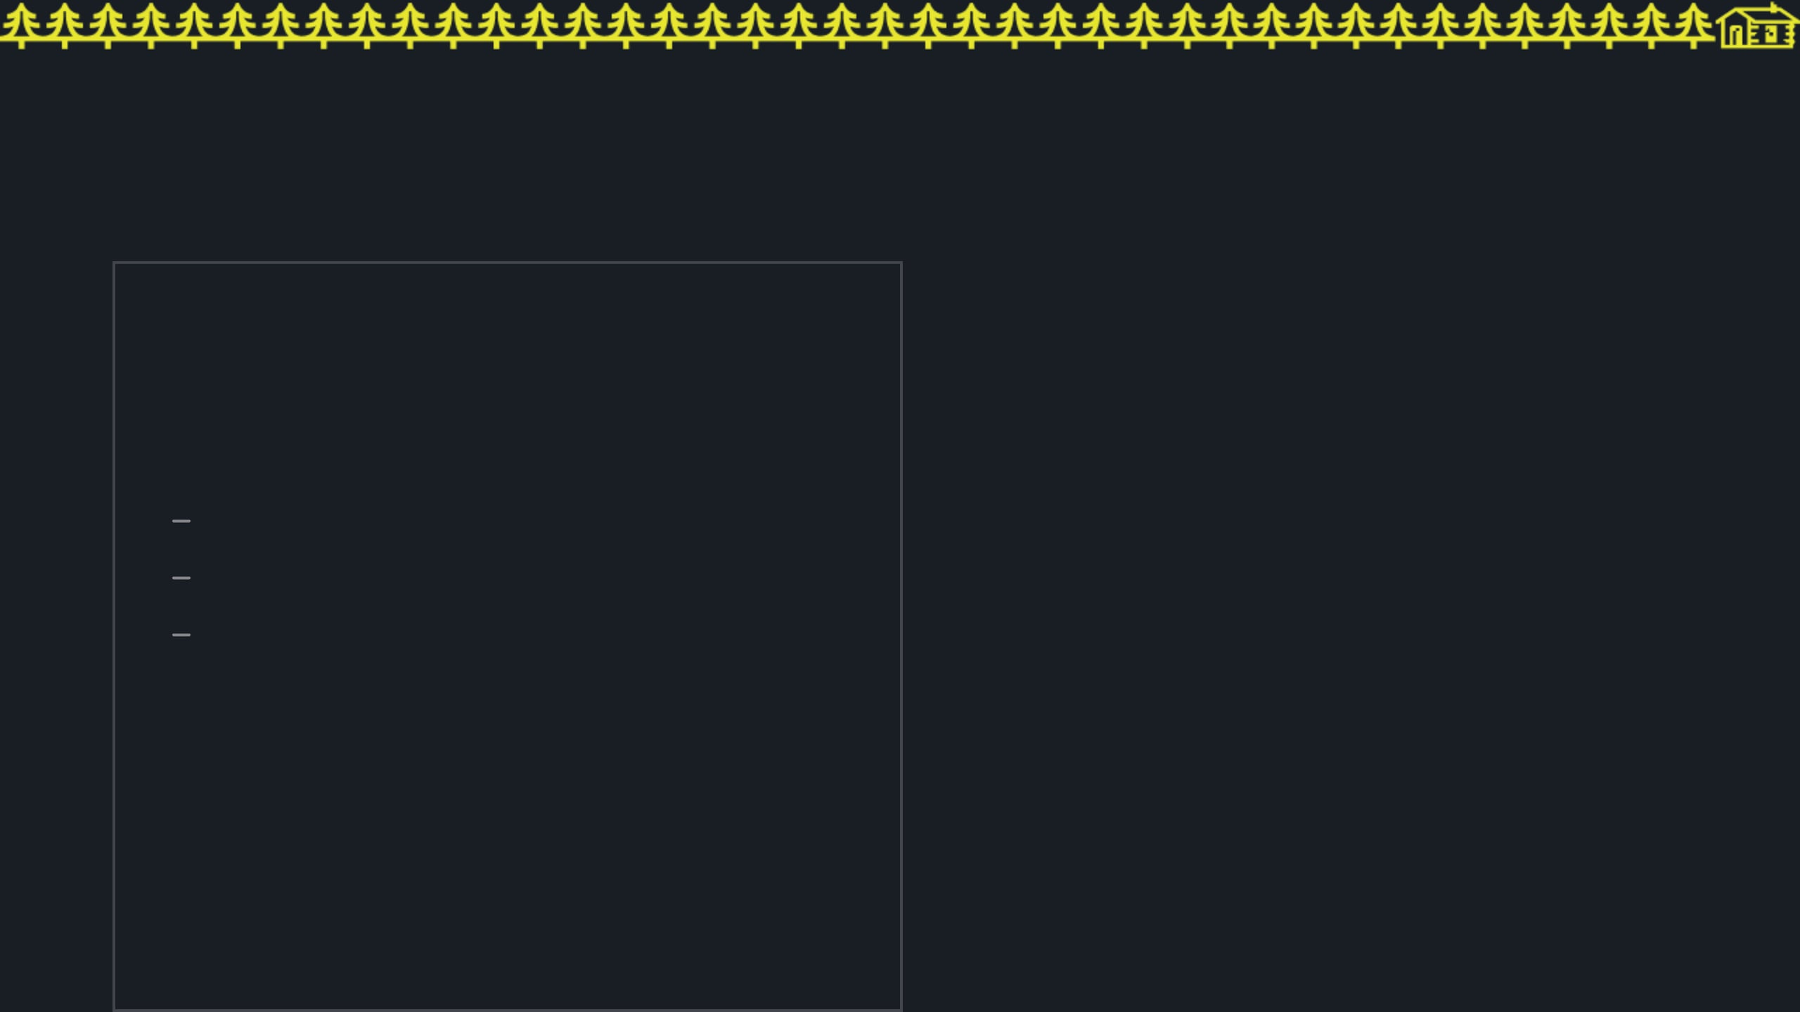


THE CHOICE
OPTION A: THE STATUS QUO
OPTION B: THE NORTH PATH
CONTINUE MONITORING
RECOVER YOUR REVENUE
$25K+ monthly margin drain
$300K+ annual margin recovery
Continued IT backlog
6-week "white-glove" deployment
Neutral is actually negative
Zero IT resources required
BOOK YOUR RECOVERY AUDIT
NO ACTION REQUIRED
Notes:
It's time to claim your own recovery. We offer a free surcharge recovery audit to show you exactly what you're leaving on the table. You'll get a state compliance map, a NetSuite readiness assessment, and a fixed-fee implementation quote. Scan the QR code or click the link in the chat to book your audit. Don't delay; our slots are limited, and every day you wait is another day you're paying fees you don't have to.

